Slide 1
RNN + LSTM & Generating Sequences With Recurrent Neural Networks
Alex Graves
Presenter: Sungjoon Choi

Slide 2




Slide 3
Contents
Structures of Recurrent Neural Networks (RNNs)
Back Propagation through Time
Generating Sequences from RNNs
Experimental Results
Conclusion

Slide 4



Feed forward Neural Network
$$Y$$
$$h$$
$$X$$

Slide 5



Recurrent Neural Network
$$Y_{t}$$
$$h_{t}$$
$$X_{t}$$

Slide 6
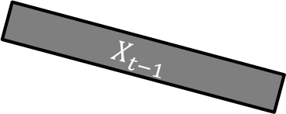
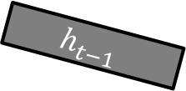

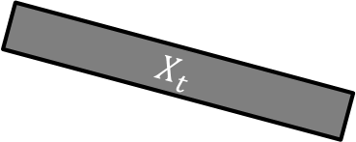
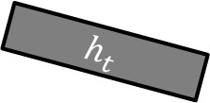

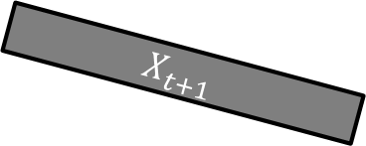
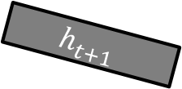

Recurrent Neural Network
$$Y_{t−1}$$
$$Y_{t}$$
$$Y_{t+1}$$
$$h_{t−1}$$
$$h_{t}$$
$$h_{t+1}$$
$$X_{t−1}$$
$$X_{t}$$
$$X_{t+1}$$
$$h_{t}=f_{h}\left(X_{t}, h_{t−1}\right)=φ_{h}\left(W^{T}h_{t−1}+U^{T}X_{t}\right)$$
$$Y_{t}=f_{o}\left(h_{t}\right)=φ_{o}\left(V^{T}h_{t}\right)$$

Slide 7
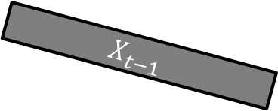
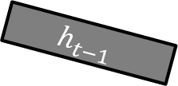

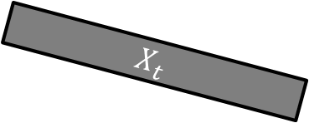
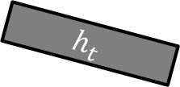


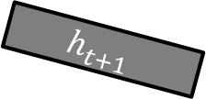

Deep Recurrent Neural Network
$$Y_{t−1}$$
$$Y_{t}$$
$$Y_{t+1}$$
$$h_{t−1}$$
$$h_{t}$$
$$h_{t+1}$$
$$X_{t−1}$$
$$X_{t}$$
$$X_{t+1}$$
$$h_{t}=f_{h}\left(X_{t}, h_{t−1}\right)=φ_{h}\left(W^{T}h_{t−1}+U^{T}X_{t}\right)$$
$$Y_{t}=f_{o}\left(h_{t}\right)=φ_{o}\left(V^{T}h_{t}\right)$$
$$h_{t}=f_{h}\left(X_{t}, h_{t−1}\right)=φ_{h}\left(g_{W}\left(h_{t−1}\right)+g_{U}\left(X_{t}\right)\right)$$
$$Y_{t}=f_{o}\left(h_{t}\right)=φ_{o}\left(g_{V}\left(h_{t}\right)\right)$$

Slide 8






Stacked Recurrent Neural Network
$$Y_{t−1}$$
$$Y_{t}$$
$$Y_{t+1}$$
$$g_{t−1}$$
$$g_{t}$$
$$g_{t+1}$$
$$h_{t−1}$$
$$h_{t}$$
$$h_{t+1}$$
$$X_{t−1}$$
$$X_{t}$$
$$X_{t+1}$$
$$h_{t}=f_{h}\left(X_{t}, h_{t−1}\right)=φ_{h}\left(W^{T}h_{t−1}+U^{T}X_{t}\right)$$
$$g_{t}=f_{g}\left(h_{t}, g_{t−1}\right)=φ_{h}\left(P^{T}g_{t−1}+Q^{T}h_{t}\right)$$
$$Y_{t}=f_{o}\left(g_{t}\right)=φ_{o}\left(V^{T}g_{t}\right)$$

Slide 9
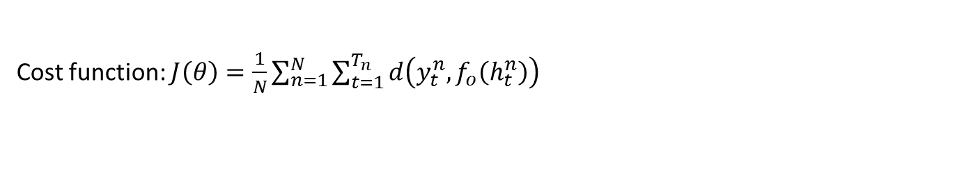
Training
$$Y_{t−1}$$
$$Y_{t}$$
$$Y_{t+1}$$
$$h_{t−1}$$
$$h_{t}$$
$$h_{t+1}$$
$$X_{t−1}$$
$$X_{t}$$
$$X_{t+1}$$
$$h_{t}=f_{h}\left(X_{t}, h_{t−1}\right)=φ_{h}\left(W^{T}h_{t−1}+U^{T}X_{t}\right)$$
$$Y_{t}=f_{o}\left(h_{t}\right)=φ_{o}\left(V^{T}h_{t}\right)$$
Given $D={\left\{\left(x_{1}^{n}, y_{1}^{n}\right), \left(x_{2}^{n}, y_{2}^{n}\right), …, \left(x_{T_{n}}^{n}, y_{T_{n}}^{n}\right)\right\}}_{n=1}^{N}$
Cost function: $J\left(θ\right)=\frac{1}{N}\sum_{n=1}^{N}{\sum_{t=1}^{T_{n}}{d\left(y_{t}^{n}, f_{o}\left(h_{t}^{n}\right)\right)}}$

Slide 10
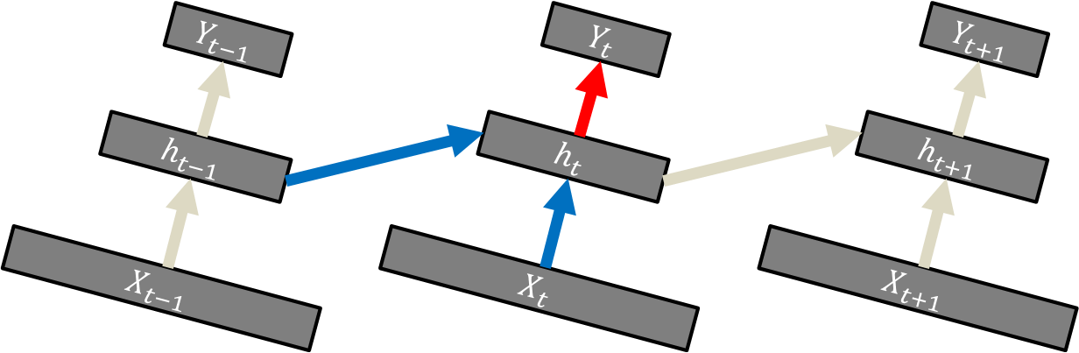

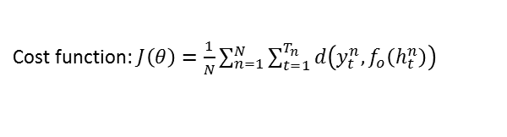
Training
$$h_{t}=f_{h}\left(X_{t}, h_{t−1}\right)=φ_{h}\left(W^{T}h_{t−1}+U^{T}X_{t}\right)$$
$$Y_{t}=f_{o}\left(h_{t}\right)=φ_{o}\left(V^{T}h_{t}\right)$$
Given $D={\left\{\left(x_{1}^{n}, y_{1}^{n}\right), \left(x_{2}^{n}, y_{2}^{n}\right), …, \left(x_{T_{n}}^{n}, y_{T_{n}}^{n}\right)\right\}}_{n=1}^{N}$
Cost function: $J\left(θ\right)=\frac{1}{N}\sum_{n=1}^{N}{\sum_{t=1}^{T_{n}}{d\left(y_{t}^{n}, f_{o}\left(h_{t}^{n}\right)\right)}}$
$$h_{1}=φ_{h}\left(W^{T}h_{0}+U^{T}X_{1}\right)$$
$$h_{2}=φ_{h}\left(W^{T}φ_{h}\left(W^{T}h_{0}+U^{T}X_{1}\right)+U^{T}X_{2}\right)$$
$$h_{3}=φ_{h}\left(W^{T}φ_{h}\left(W^{T}φ_{h}\left(W^{T}h_{0}+U^{T}X_{1}\right)+U^{T}X_{2}\right)+U^{T}X_{3}\right)$$
$$h_{4}=φ_{h}\left(W^{T}φ_{h}\left(W^{T}φ_{h}\left(W^{T}φ_{h}\left(W^{T}h_{0}+U^{T}X_{1}\right)+U^{T}X_{2}\right)+U^{T}X_{3}\right)+U^{T}X_{4}\right)$$
$${\tilde{y}}_{1}=φ_{o}\left(φ_{h}\left(W^{T}h_{0}+U^{T}X_{1}\right)\right)$$
$${\tilde{y}}_{2}=φ_{o}\left(φ_{h}\left(W^{T}φ_{h}\left(W^{T}h_{0}+U^{T}X_{1}\right)+U^{T}X_{2}\right)\right)$$
$${\tilde{y}}_{3}=φ_{o}\left(φ_{h}\left(W^{T}φ_{h}\left(W^{T}φ_{h}\left(W^{T}h_{0}+U^{T}X_{1}\right)+U^{T}X_{2}\right)+U^{T}X_{3}\right) \right)$$
$${\tilde{y}}_{4}=φ_{o}\left(φ_{h}\left(W^{T}φ_{h}\left(W^{T}φ_{h}\left(W^{T}φ_{h}\left(W^{T}h_{0}+U^{T}X_{1}\right)+U^{T}X_{2}\right)+U^{T}X_{3}\right)+U^{T}X_{4}\right) \right)$$
$$J\left(W, V, U\right)={\left(y_{1}−{\tilde{y}}_{1}\right)}^{2}+{\left(y_{2}−{\tilde{y}}_{2}\right)}^{2}+{\left(y_{3}−{\tilde{y}}_{3}\right)}^{2}+⋯$$

Slide 11
Training
$$h_{t}=f_{h}\left(X_{t}, h_{t−1}\right)=φ_{h}\left(W^{T}h_{t−1}+U^{T}X_{t}\right)$$
$$Y_{t}=f_{o}\left(h_{t}\right)=φ_{o}\left(V^{T}h_{t}\right)$$
Given $D={\left\{\left(x_{1}^{n}, y_{1}^{n}\right), \left(x_{2}^{n}, y_{2}^{n}\right), …, \left(x_{T_{n}}^{n}, y_{T_{n}}^{n}\right)\right\}}_{n=1}^{N}$
Cost function: $J\left(θ\right)=\frac{1}{N}\sum_{n=1}^{N}{\sum_{t=1}^{T_{n}}{d\left(y_{t}^{n}, f_{o}\left(h_{t}^{n}\right)\right)}}$
$$h_{1}=φ_{h}\left(W^{T}h_{0}+U^{T}X_{1}\right)$$
$$h_{2}=φ_{h}\left(W^{T}φ_{h}\left(W^{T}h_{0}+U^{T}X_{1}\right)+U^{T}X_{2}\right)$$
$$h_{3}=φ_{h}\left(W^{T}φ_{h}\left(W^{T}φ_{h}\left(W^{T}h_{0}+U^{T}X_{1}\right)+U^{T}X_{2}\right)+U^{T}X_{3}\right)$$
$$h_{4}=φ_{h}\left(W^{T}φ_{h}\left(W^{T}φ_{h}\left(W^{T}φ_{h}\left(W^{T}h_{0}+U^{T}X_{1}\right)+U^{T}X_{2}\right)+U^{T}X_{3}\right)+U^{T}X_{4}\right)$$
$${\tilde{y}}_{1}=φ_{o}\left(φ_{h}\left(W^{T}h_{0}+U^{T}X_{1}\right)\right)$$
Vanishing / Exploding Gradient
$${\tilde{y}}_{2}=φ_{o}\left(φ_{h}\left(W^{T}φ_{h}\left(W^{T}h_{0}+U^{T}X_{1}\right)+U^{T}X_{2}\right)\right)$$
$${\tilde{y}}_{3}=φ_{o}\left(φ_{h}\left(W^{T}φ_{h}\left(W^{T}φ_{h}\left(W^{T}h_{0}+U^{T}X_{1}\right)+U^{T}X_{2}\right)+U^{T}X_{3}\right) \right)$$
$${\tilde{y}}_{4}=φ_{o}\left(φ_{h}\left(W^{T}φ_{h}\left(W^{T}φ_{h}\left(W^{T}φ_{h}\left(W^{T}h_{0}+U^{T}X_{1}\right)+U^{T}X_{2}\right)+U^{T}X_{3}\right)+U^{T}X_{4}\right) \right)$$
$$J\left(W, V, U\right)={\left(y_{1}−{\tilde{y}}_{1}\right)}^{2}+{\left(y_{2}−{\tilde{y}}_{2}\right)}^{2}+{\left(y_{3}−{\tilde{y}}_{3}\right)}^{2}+⋯$$

Slide 12




Unfolding in Time
$$X\left(t\right)$$
$$w$$
$$h\left(t+1\right)$$
$$g$$

Slide 13












Unfolding in Time
$$X\left(t\right)$$
$$w$$
$$h\left(t+1\right)$$
$$g$$
$$x\left(0\right)$$
$$x\left(1\right)$$
$$x\left(2\right)$$
$$w$$
$$w$$
$$w$$
$$h\left(0\right)$$
$$h\left(1\right)$$
$$h\left(2\right)$$
$$g$$
$$g$$
$$g$$

Slide 14
Unfolding in Time
$$X\left(t\right)$$
$$w$$
$$h\left(t+1\right)$$
$$g$$
$$x\left(0\right)$$
$$x\left(1\right)$$
$$x\left(2\right)$$
$$w$$
$$w$$
$$w$$
$$h\left(0\right)$$
$$h\left(1\right)$$
$$h\left(2\right)$$
$$g$$
$$g$$
$$g$$

Slide 15



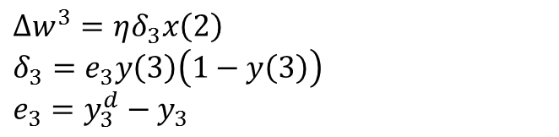









Back-propagation through Time
$$x\left(0\right)$$
$$x\left(1\right)$$
$$x\left(2\right)$$
$$w$$
$$w$$
$$w$$
$$y\left(0\right)$$
$$y\left(1\right)$$
$$y\left(2\right)$$
$$g$$
$$g$$
$$g$$
Now it is a 3 layer feed-forward multi-layer network which can be optimized via standard delta rule.
$∆w^{3}=ηδ_{3}x\left(2\right)$
$δ_{3}=e_{3}y\left(3\right)\left(1−y\left(3\right)\right)$
$e_{3}=y_{3}^{d}−y_{3}$
It is called “back-propagation through time”.

Slide 16




Gated Recurrent Unit (GRU)
$$Y_{t}$$
$$h_{t−1}$$
$$h_{t}$$
$$X_{t}$$
Simple RNN

Slide 17










Gated Recurrent Unit (GRU)
$$Y_{t}$$
$$h_{t−1}$$
$$\tilde{h}$$
$$h_{t}$$
+
$$r$$
$$1−z$$
$$z$$
$$r$$
$$z$$
Reset Gate
$\left(0\sim 1\right)$
Dynamic Gate
$\left(0\sim 1\right)$
$$X_{t}$$
Gated Recurrent Unit

Slide 18













Long Short-term Memory (LSTM)
$$X_{t}$$
$$X_{t}$$
Input Gate
$$i_{t}$$
Output Gate
$$o_{t}$$
$$c_{t}$$
$$X_{t}$$
$$φ$$
$$×$$
$$φ$$
$$×$$
$$h_{t}$$
$$×$$
$$f_{t}$$
Forget Gate
$$X_{t}$$

Slide 19
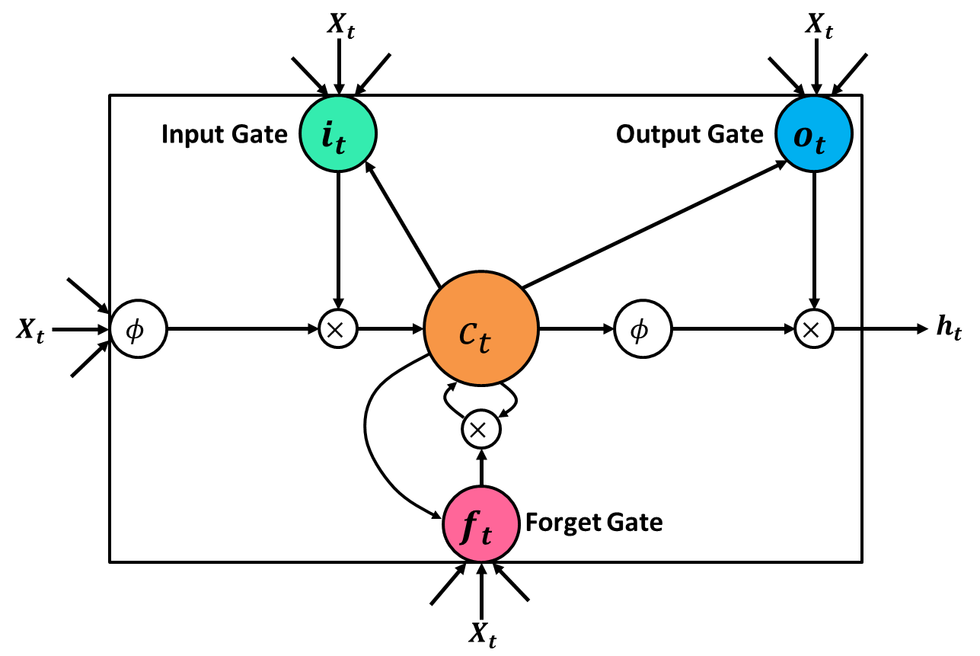
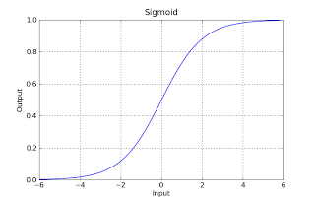
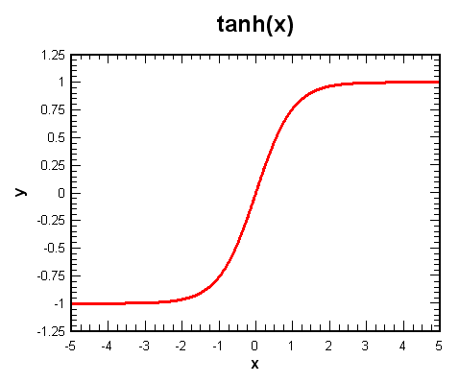
Long Short-term Memory (LSTM)
$$θ=\left\{W_{xi},W_{hi},W_{ci},W_{xf},W_{hf},W_{cf},W_{xc},W_{hc},W_{xo},W_{ho}, W_{co}, b_{i}, b_{f}, b_{c}, b_{o}\right\}$$
$$i_{t}=σ\left(W_{xi}x_{t}+W_{hi}h_{t−1}+W_{ci}c_{t−1}+b_{i}\right)$$
$$f_{t}=σ\left(W_{xf}x_{t}+W_{hf}h_{t−1}+W_{cf}c_{t−1}+b_{f}\right)$$
$$c_{t}=f_{t}c_{t−1}+i_{t}\tanh\left(W_{xc}x_{t}+W_{hc}h_{t−1}+b_{c}\right)$$
$$o_{t}=σ\left(W_{xo}x_{t}+W_{ho}h_{t−1}+W_{co}c_{t}+b_{o}\right)$$
$$h_{t}=o_{t}\tanh\left(c_{t}\right)$$

Slide 20
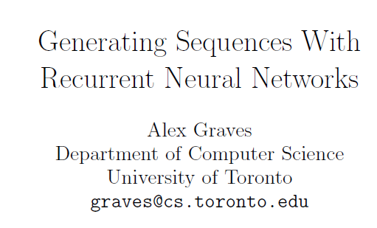
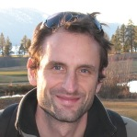
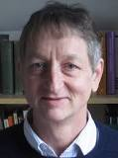



Slide 21
Generating Sequences With RNN
This paper focuses on the problem of generating sequences
Obvious way to do this is to repeatedly predict what will happen next
$\operatorname{Pr}\left(x\right)=\prod_{t}{\operatorname{Pr}\left(x_{t}|x_{1:t−1}\right) }$

Slide 22
The Role of Memory
Need to remember the past to predict the future
Having a longer memory has several advantages:
can store and generate longer range patterns
more robust to ‘mistakes’
Basic RNN often fail to do this

Slide 23
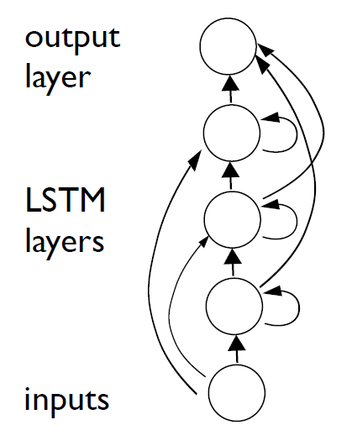
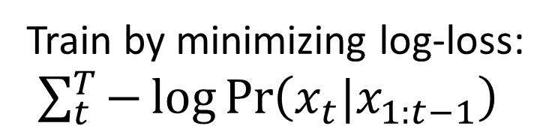
Basic Architecture
So LSTM is widely used as a building block of RNN
It is called Deep recurrent LSTM net
Train by minimizing log-loss:
$\sum_{t}^{T}{−\log{\operatorname{Pr}\left(x_{t}|x_{1:t−1}\right)}}$
Generation can be done by sampling from output and feeding into input

Slide 24
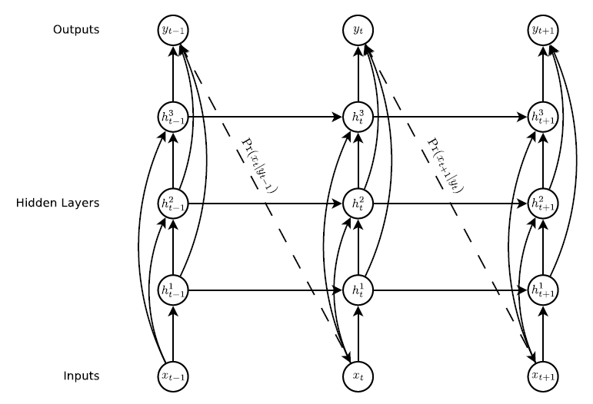
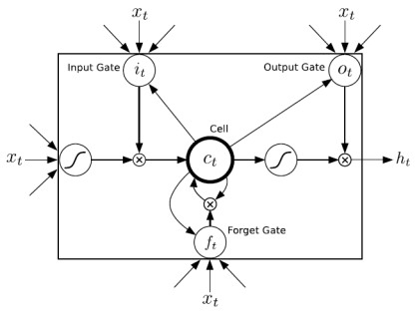
Prediction Network
Generation is NOT yet

Slide 25
Long Short-term Memory (LSTM)
$$θ=\left\{W_{xi},W_{hi},W_{ci},W_{xf},W_{hf},W_{cf},W_{xc},W_{hc},W_{xo},W_{ho}, W_{co}, b_{i}, b_{f}, b_{c}, b_{o}\right\}$$
$$i_{t}=σ\left(W_{xi}x_{t}+W_{hi}h_{t−1}+W_{ci}c_{t−1}+b_{i}\right)$$
$$f_{t}=σ\left(W_{xf}x_{t}+W_{hf}h_{t−1}+W_{cf}c_{t−1}+b_{f}\right)$$
$$c_{t}=f_{t}c_{t−1}+i_{t}\tanh\left(W_{xc}x_{t}+W_{hc}h_{t−1}+b_{c}\right)$$
$$o_{t}=σ\left(W_{xo}x_{t}+W_{ho}h_{t−1}+W_{co}c_{t}+b_{o}\right)$$
$$h_{t}=o_{t}\tanh\left(c_{t}\right)$$

Slide 26
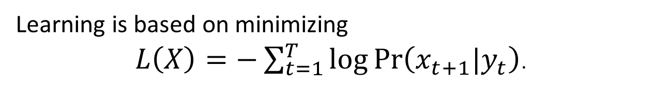
Prediction Network
No explicit output is given.
Choosing proper $\operatorname{Pr}\left(x_{t+1}|y_{t}\right)$ is important.
Learning is based on minimizing
$L\left(X\right)=−\sum_{t=1}^{T}{\log{\operatorname{Pr}\left(x_{t+1}|y_{t}\right)}}$.

Slide 27
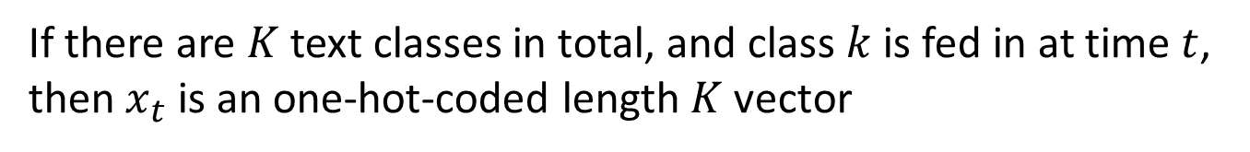

Text Prediction
If there are $K$ text classes in total, and class $k$ is fed in at time $t$,
then $x_{t}$ is an one-hot-coded length $K$ vector
$$\operatorname{Pr}\left(x_{t+1}=k|y_{t}\right)=\frac{\exp\left({\hat{y}}_{t}^{k}\right)}{\sum_{k^{′}=1}^{K}{\exp\left({\hat{y}}_{t}^{k′}\right)}}$$

Slide 28
Handwriting Prediction
Mixture Density Network
Outputs of neural network parametrize a mixture distribution
Inputs of neural network consist of pen offsets and end of stroke

Slide 29
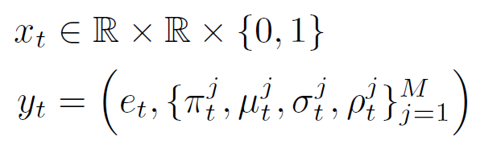
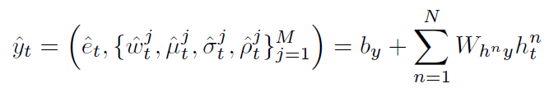
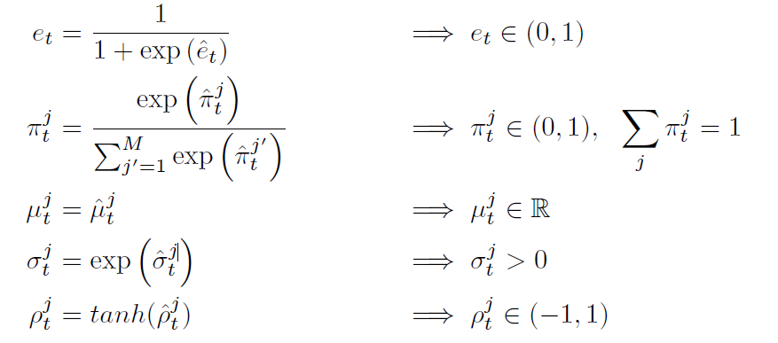
Handwriting Prediction
Mixture Density Network for Handwriting Prediction
Input and Output of Network
More specifically,
end of stroke
weight
mean
variance
correlation

Slide 30
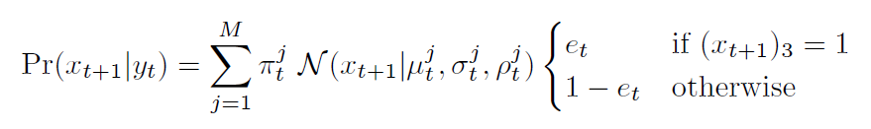
Handwriting Prediction
Outputs
: Parameters of mixture model for next inputs (displacement + end of stroke)
Inputs
: Pen displacement + end of stroke
End of stroke as Bernoulli
Next pen displacement as mixture of Gaussians

Slide 31
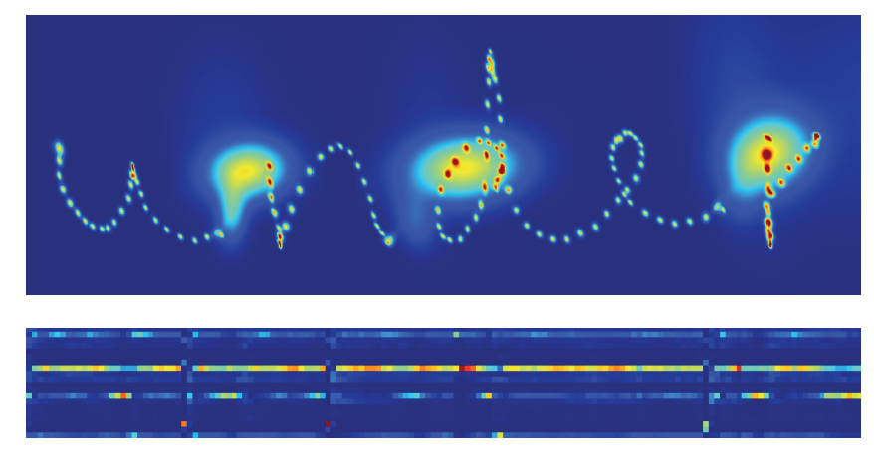
Handwriting Prediction

Slide 32
Experiments
Network architecture
3 inputs – 2 displacements, 1 end of stroke
3 hidden layers – each with 400 LSTM cells
121 outputs
– 20 weights, 40 means, 40 stds, 20 correlations, 1 end of stroke
→ 3.4M weight parameters

Slide 33
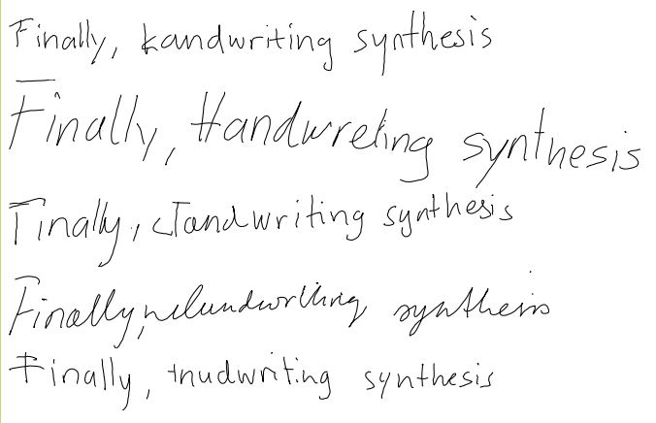
Handwriting Synthesis

Slide 34
Handwriting Synthesis
Given sequence of characters, how can we generate handwriting?
Clearly, the prediction networks CANNOT do this
Main problem is that the length of sequences of characters and hand writings varies greatly
‘Soft window’ model is used!

Slide 35
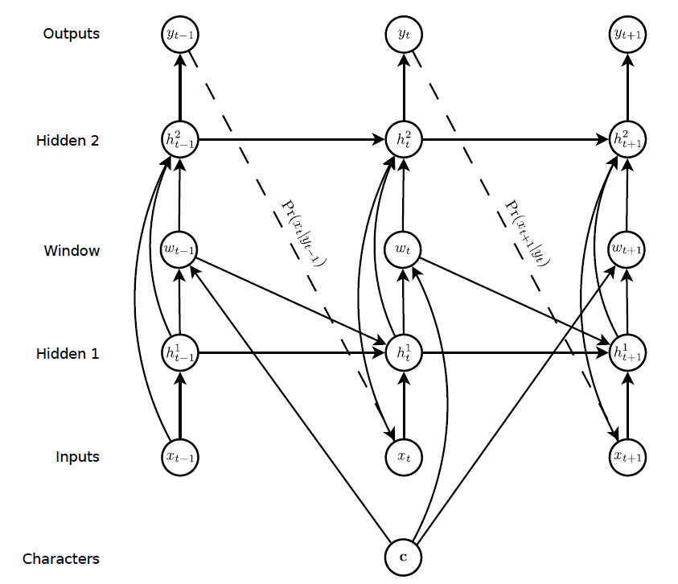
Synthesis Network

Slide 36
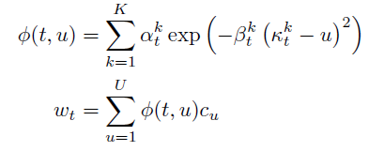
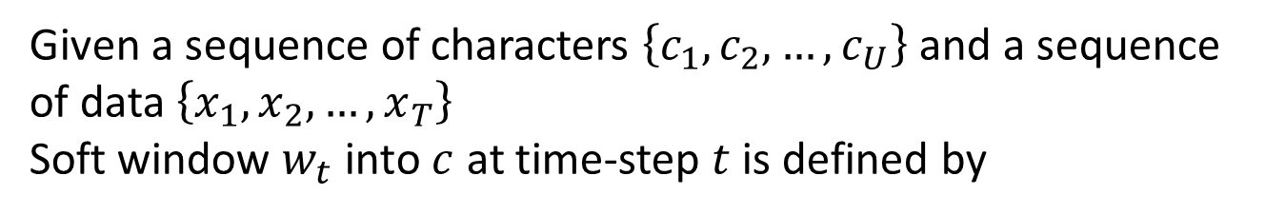
Synthesis Network
Given a sequence of characters $\left\{c_{1}, c_{2}, …, c_{U}\right\}$ and a sequence of data $\left\{x_{1}, x_{2}, …, x_{T}\right\}$
Soft window $w_{t}$ into $c$ at time-step $t$ is defined by

Slide 37

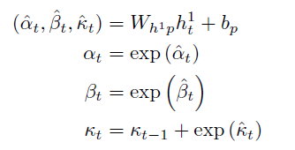





Synthesis Network
$u$: index of word
$φ\left(t, u\right)$: window weight of $c_{u}$ at time $t$
$κ_{t}^{k}$: location of the window
$β_{t}$: width of the window
$α_{t}$: importance of the window

Slide 38
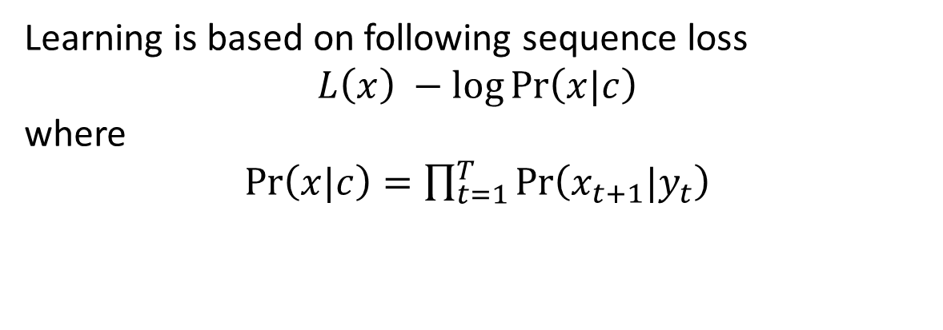
Synthesis Network
Learning is based on following sequence loss
$$L\left(x\right) −\log{\operatorname{Pr}\left(x|c\right)}$$
where
$\operatorname{Pr}\left(x|c\right)=\prod_{t=1}^{T}{\operatorname{Pr}\left(x_{t+1}|y_{t}\right)}$

Slide 39


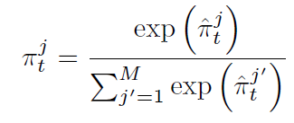
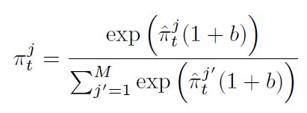
Heuristics
1. How long should we keep writing a character?
$$φ\left(t, U+1\right)>φ\left(t, u\right) ∀1≤u≤U$$
2. Biased sampling for better readability
→ Reduce standard deviation by

Slide 40
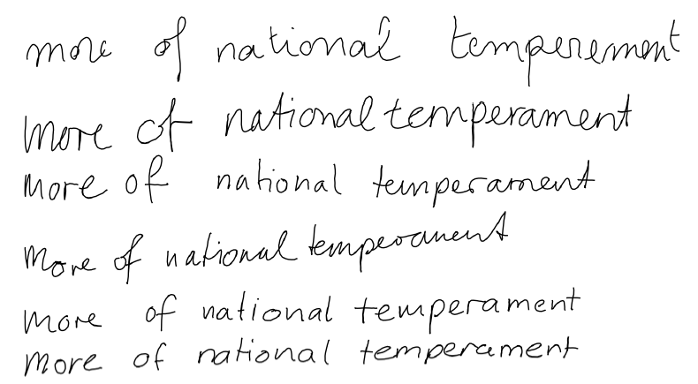
Biased Sampling

Slide 41



Conclusion
LSTM is important in now days
RNN is a deterministic model
However, it is also possible to generate sequences
Heuristics are required for synthesis
Has a lot of opportunity

